Slide 1
Shubhvivah.com Matrimony site
.

Slide 2
INTRODUCTION
Matrimonial Services is a web portalwhich willprovide all marriage relatedservices & collect all service .
Matrimonial Services is an online service which is use to place all wedding service providers on one platform.
Its one kind of Business-to-Consumer (B2C)
By this site register the candidates and manage their activities through our portals

Slide 3
PLATFORMS and TOOLS
Software Requirment :
Python 3.5
Django Framwork
MySQL
HTML
CSS
Bootstrap

Slide 4
Hardware Requirment :
1.6 GHz or faster processor
Minimum 512 MB RAM
32 bit OS .
Minimum 2 GB space
Image Scanner

Slide 5
OBJECTIVE
To provide a common interface for all.
To provide all best possible services for marriage.
To provide all best deals to vendors & customers.
To make it most popular way of searching suitable matched.
To facilitate vendors search.
To facilitate candidates so that he or she can search for best matching available.
To help parents to get good options.
To act as a middle men connecting parties.

Slide 6
SERVICES
Wedding Venues
Wedding Planners & Contractors
Beauty & Grooming
Wedding Photographers
Decorators
Honeymoon Packages
Hotels & Accommodation
Music & Entertainment
Background Verification & Detective Services

Slide 7
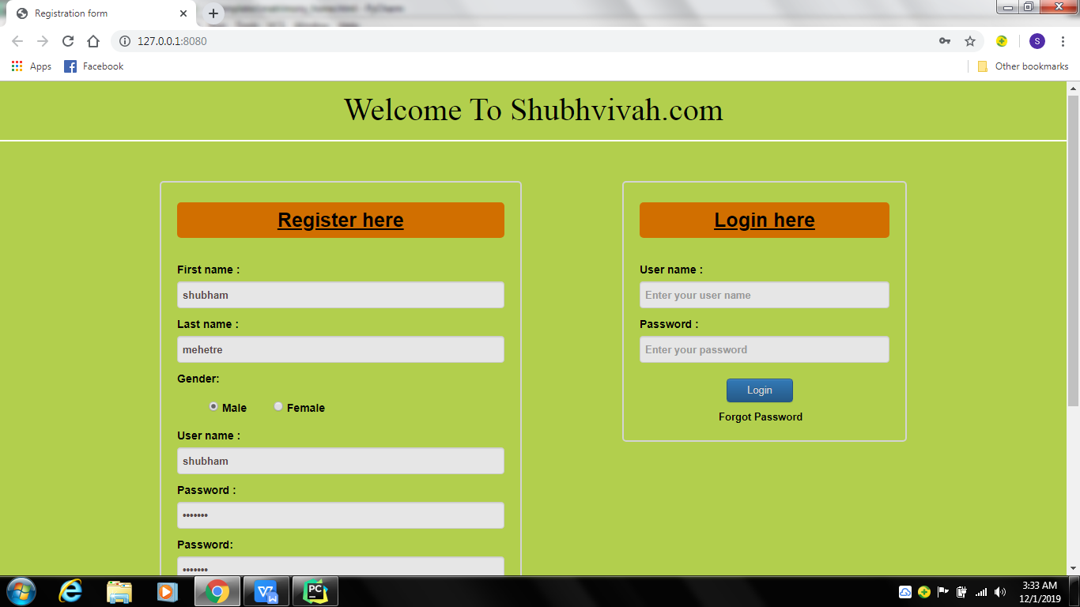
SCREEN SHOTS
Registetration :

Slide 8
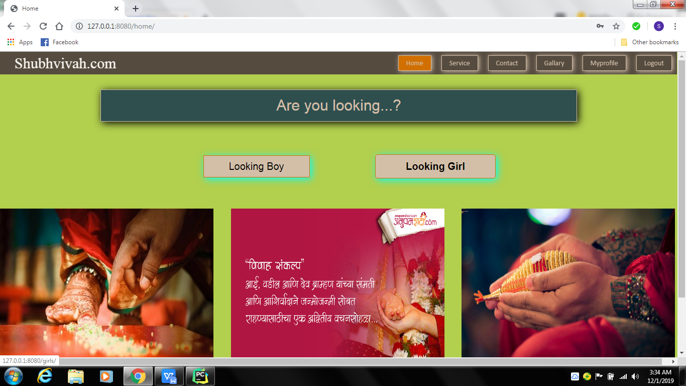
Home :

Slide 9
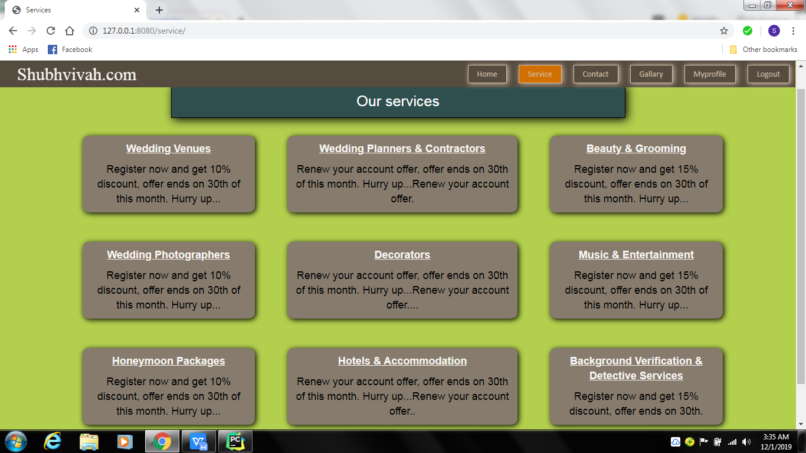
Services :

Slide 10
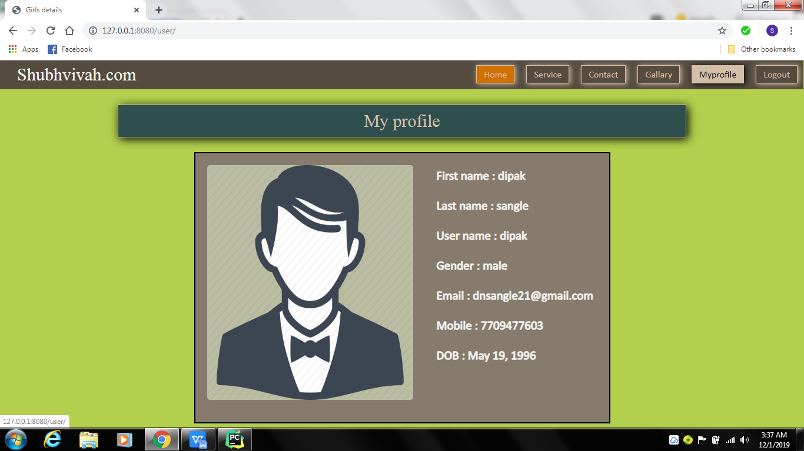
My Profile :

Slide 11
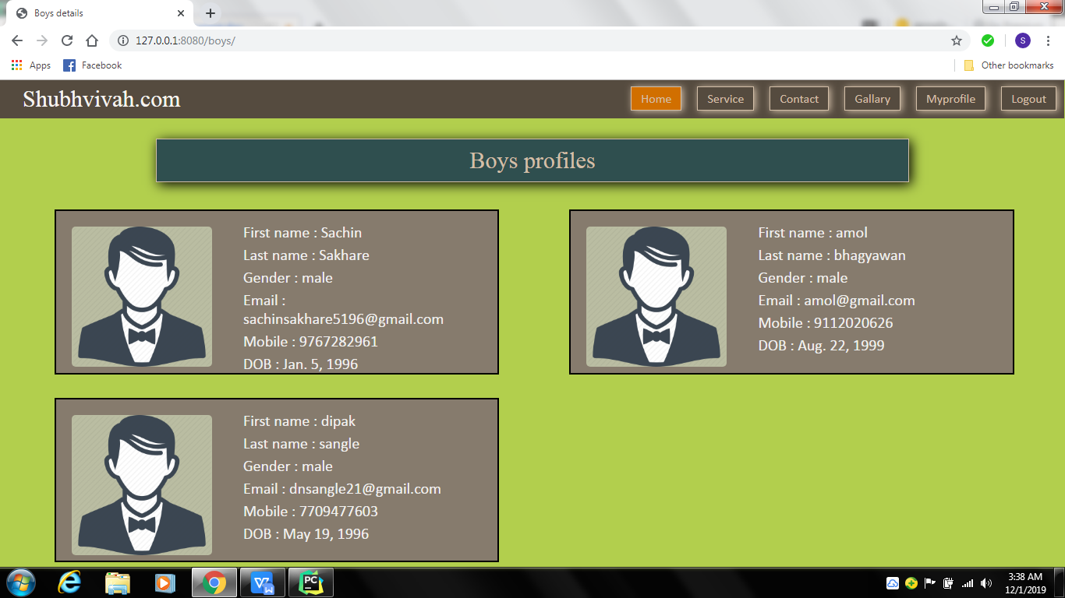
Boys Profile:

Slide 12
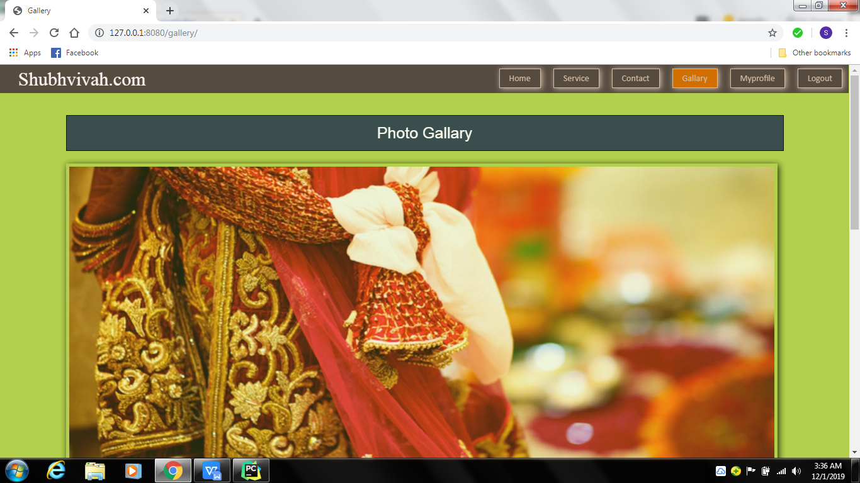
Gallary:

Slide 13
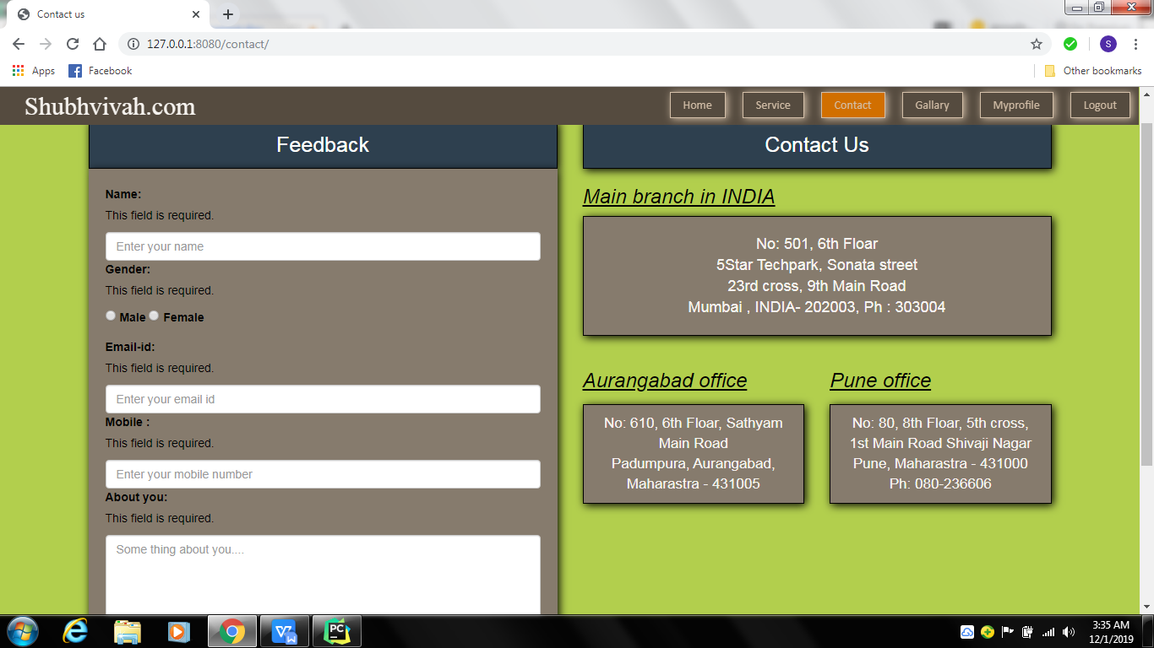
Contact & Feedback:

Slide 14
CONCLUSION
Matrimonial web application providefacility like quick tour. This is a module that contains the flow of the website .Here user can have a idea
how he can commit himself in the website.
This application provide facility like edit profile, update photo and delete photo, hide profile, create album, send express interest, send personal message to the user.

Slide 15

Thank You

